Slide 1
SAP FICO Reports – Types, Uses, and Benefits
WEEK 4 INTERNSHIP REPORT
Prepared as part of the SAP FICO Internship at Yuva Intern
Student Name: Ashish Kumar | Roll Number: 25SCS1003003125
Course / Department: B.Tech (CSE) | College / University: IILM University Greater Noida
Internship Organisation: Yuva Intern | Internship Title: SAP FICO Internship
Week: 4 | Submission Date: 06/09/2026

Slide 2
Table of Contents
01
Introduction
What SAP FICO is and why reports matter
03
Importance of SAP FICO Reporting
Why organisations need these reports
05
SAP CO Reports
Cost Centre, Profit Centre, Internal Orders, and Profitability Analysis
07
Benefits and Challenges
Advantages, limitations, and S/4HANA
02
Understanding SAP FICO Reports
Types, purposes, and categories
04
Types of SAP FI Reports
G/L, AP, AR, Asset, Tax, and Financial Statements
06
Real-World Example
ABC Electronics Pvt. Ltd.
08
Learning Outcomes and Conclusion
Reflections and key takeaways

Slide 3
Introduction
SAP FICO is the financial and management accounting module within SAP ERP. FI (Financial Accounting) handles external reporting — things like balance sheets and profit and loss statements. CO (Controlling) handles internal reporting — things like cost analysis and profitability. Together, they give organisations a complete picture of their finances.
An SAP report is a structured output of business transaction data. Every time a company records a sale, makes a purchase, or pays a supplier, SAP captures that information. Reports pull this data together and present it in a way that is useful for accountants and managers.
Reports are important because raw transaction data alone is not very useful. A list of hundreds of journal entries does not tell a manager whether the business is profitable. SAP reports convert that raw data into summaries, comparisons, and trends that support decision-making.
Business Transactions
SAP FI s CO Capture
SAP Reports
Management Decisions
During Week 4 of my internship at Yuva Intern, I studied the different types of SAP FICO reports, what they show, who uses them, and how they support financial management. This report summarises my learning.

Slide 4
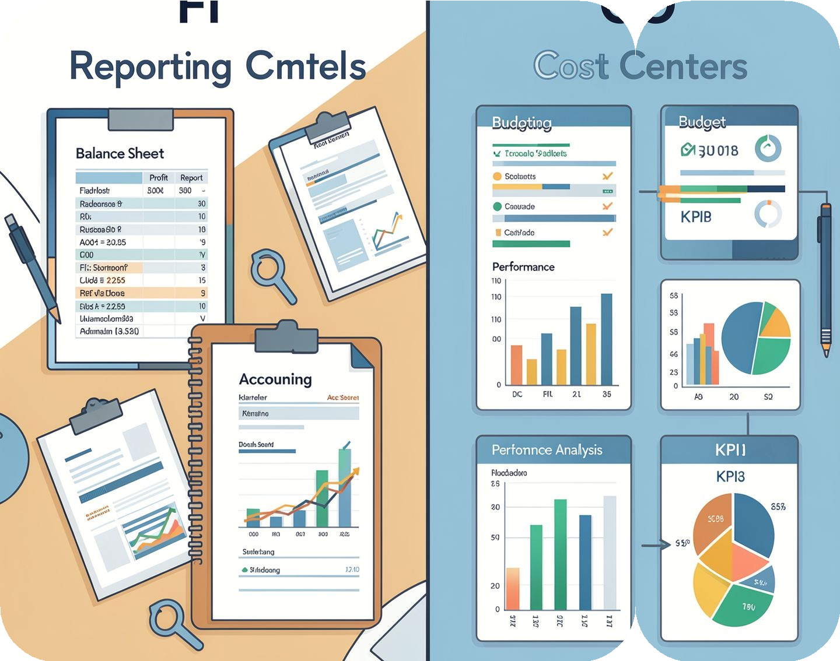
Understanding SAP FICO Reports
A report in SAP is simply a way to view and analyse data. Financial reporting shows the overall financial position of a company. Management reporting helps internal teams understand costs, revenues, and performance. SAP FICO reports fall into two main categories: FI reports for external financial accounting, and CO reports for internal cost and profitability analysis.
Reports can also be classified as standard (built into SAP) or customised (built for a specific company's needs). They can be operational (for day-to-day monitoring) or analytical (for deeper analysis and decision-making). SAP also supports real-time reporting, where data is available immediately after a transaction is posted. Accurate master data and transaction data are essential — if the input data is wrong, the reports will be wrong too.
Report Type | Main Purpose | Example
FI Report | Financial accounting and external reporting | G/L account balances
CO Report | Internal cost analysis | Cost centre report
Operational Report | Day-to-day monitoring | Open invoices
Analytical Report | Analysis and decision-making | Profitability analysis
FI Reports
External focus: balance sheet, P&L, compliance, statutory reporting
CO Reports
Internal focus: cost centres, profit centres, budgeting, performance analysis
The diagram above shows the key difference: FI reports answer "what happened financially?" while CO reports answer "where did costs occur and how is the business performing?"

Slide 5






Importance of SAP FICO Reporting
Organisations need SAP FICO reports because financial data without structure is difficult to act on. Reports give finance teams and management the information they need to monitor, control, and improve business performance. Below are the key reasons why these reports matter.
Financial Monitoring
Reports give a clear view of the company's financial position at any point in time. Management can see revenues, expenses, and balances without manually checking individual transactions.
Expense Tracking
Cost centre and G/L reports show exactly where money is being spent. For example, if electricity costs are rising, a G/L report on the electricity expense account can confirm this.
Cash Flow Management
AP and AR aging reports show which invoices are due and when. This helps finance teams plan payments and avoid cash shortages.
Profitability Analysis
Profit centre and CO-PA reports show which products, customers, or regions are most profitable. This helps management focus resources on the right areas.
Budget vs Actual
Plan vs actual reports compare what was planned with what actually happened. If a department overspent, variance reports highlight this immediately.
Tax and Compliance
Tax reports summarise input and output tax, helping companies meet statutory requirements. In India, SAP can support GST-related financial information through proper configuration.

Slide 6

Types of SAP FI Reports
SAP FI reports cover all areas of financial accounting. Each category serves a specific purpose and is used by different teams within the finance department. The exact reports available can vary depending on the SAP version (ECC or S/4HANA) and the company's configuration.
General Ledger Reports
G/L reports show balances and transactions for all accounts. They include account balance reports, line-item reports, and the trial balance. For example, if a company wants to know how much it spent on electricity in a month, a G/L report on the electricity expense account provides the answer.
Accounts Payable Reports
AP reports help track money owed to suppliers. They include vendor balances, open items, cleared items, and aging reports. A finance employee can use an AP aging report to see which supplier invoices are due this week and plan payments accordingly.
Accounts Receivable Reports
AR reports track money owed by customers. They include customer balances, open items, and aging reports. If a company wants to identify customers who have not paid invoices for more than 60 days, an AR aging report makes this easy.
Asset Accounting Reports
Asset reports track fixed assets like machines, computers, and vehicles. They show acquisition costs, depreciation, and current book value. For example, a company can use asset reports to see the remaining value of a machine purchased three years ago.
FI Report Category
What It Shows
Who Uses It
General Ledger
All account balances and transactions
Finance, Accountants
Accounts Payable Supplier invoices and payments AP Team, Finance
Accounts Receivable Customer invoices and receipts AR Team, Finance
Asset Accounting Fixed asset values and depreciation Asset Accountant
Tax Reports Input/output tax summaries Tax Team, Finance Financial Statements Balance Sheet, P&L, Cash Flow Management, Auditors
Invoice Received
Posted in SAP FI
AP Report Generated
Payment Planned
This flow shows how AP reporting works in practice — from receiving an invoice to making the payment, with SAP reports supporting each step.

Slide 7
Financial Statements in SAP FICO
Financial statements are among the most important outputs of SAP FI. They provide a formal summary of a company's financial position and performance. SAP can generate these statements directly from the data stored in the system, reducing manual effort and improving accuracy.
Balance Sheet
The balance sheet shows what a company owns (assets), what it owes (liabilities), and the owner's equity. It represents the financial position at a specific point in time. For example, a balance sheet can show that a company has ₹50 lakh in assets and ₹20 lakh in liabilities, meaning the equity is ₹30 lakh.
Profit and Loss Statement
The P&L statement shows revenues and expenses over a period (such as a month or year). The difference between revenue and expenses is the profit or loss.
This helps management understand whether the business is making money.
Cash Flow Information
Cash flow reports show money coming in and going out of the business. They help assess liquidity — whether the company has enough cash to meet its short-term obligations. A company can be profitable on paper but still face cash flow problems if customers delay payments.
Trial Balance
The trial balance lists all G/L accounts with their debit and credit balances. It is used to check that the accounting records are balanced before preparing financial statements. If debits do not equal credits, it indicates an error that needs to be resolved.
Invoice Issued
Customer invoice created
AR Report Generated
Compile receivables report
Posted in SAP FI
Record transaction in ledger
Payment Received
Payment cleared and reconciled
This flow shows how AR reporting works — from issuing an invoice to receiving payment, with SAP reports tracking each stage.

Slide 8

SAP CO Reports
Controlling (CO) reports focus on internal management needs. While FI reports answer "what happened financially?", CO reports answer "where did the cost occur, why did it occur, and how is the business performing?" CO reports are used by department heads, cost accountants, and senior management.
CO Report Type | Purpose | Example Use
Cost Centre Report | Track department costs | Compare HR vs IT expenses
Profit Centre Report | Analyse business unit profit | TV vs Refrigerator profitability
Internal Order Report | Track project costs | Marketing campaign budget
Profitability Analysis | Customer/product profitability | Most profitable customer segment
Plan vs Actual | Budget variance | Did we overspend?
Dept Costs
Posted to CO
Report Generated
Management Action
This flow shows how cost centre reporting works — costs are recorded against departments, reports are generated, and management uses them to make decisions.
Cost Centre Reports
A cost centre is a department or function where costs are recorded. Cost centre reports show actual costs, planned costs, and the difference between them (variance). For example, if a company has HR, Marketing, Production, and IT departments, management can use cost centre reports to compare their expenses and identify areas where costs are higher than planned.
Profit Centre Reports
A profit centre is a business unit that generates both revenue and costs. Profit centre reports show the profit or loss for each unit. For example, if a company sells televisions, refrigerators, and washing machines, each product line can be a profit centre. Management can see which products are most profitable and which are underperforming.

Slide 9
Internal Orders, Profitability Analysis, and Real-World Example
Internal Order Reports
Internal orders track costs for specific activities or projects. Examples include a marketing campaign, an office renovation, or a maintenance project. Internal order reports show planned costs, actual costs, and commitments. Once the activity is complete, costs can be settled to a cost centre or asset.
Profitability Analysis (CO-PA)
CO-PA helps answer questions like "Which product generates the highest profit?" or "Which customer segment is most profitable?" It analyses revenue and costs by dimensions such as customer, product, region, or sales organisation. This helps management make informed decisions about where to invest resources.
Capture Revenue
Record sales and income
Analyze
By customer, product, or region
Report s Decide
Generate CO-PA and choose actions
Capture Costs
Log expenses and allocations
This flow shows how profitability analysis works — from capturing data to generating insights that drive strategic decisions.
Real-World Example: ABC Electronics Pvt. Ltd.
Note: ABC Electronics Pvt. Ltd. is a fictional company created for illustration purposes.
ABC Electronics is a company that sells electronic products. Different departments within the company use SAP FICO reports for different purposes. The table below shows how each department benefits from specific reports.
Department | Report Used | Purpose
Finance | Profit and Loss | Understand overall profitability
Finance | Balance Sheet | Review financial position
Accounts Payable | Vendor Aging | Track supplier dues
Accounts Receivable | Customer Aging | Track customer dues
Management | Cost Centre Report | Control department costs
Management | Profitability Report | Analyse profitable products

Slide 10

Benefits, Challenges, and SAP S/4HANA Reporting
Benefits of SAP FICO Reports
Faster access to financial information Better visibility into costs and revenues
Improved accuracy and reduced manual effort Better cost control through variance analysis Improved cash management via AP/AR reports Stronger support for compliance and audits Better planning through plan vs actual reports
Improved decision-making at all levels
Challenges and Limitations
Incorrect master or transaction data leads to wrong reports
Poor SAP configuration can limit report usefulness Some reports are complex and require training
Too much information can make it hard to find what matters
Differences between SAP ECC and S/4HANA can cause confusion
Custom reports may require developer support
Organisations can reduce these problems by ensuring data quality, providing user training, and maintaining good SAP configuration practices.
SAP FICO Reporting in S/4HANA
SAP S/4HANA is the latest version of SAP ERP. It introduces several improvements to financial reporting. The Universal Journal combines FI and CO data into a single source, eliminating reconciliation between the two. SAP Fiori provides a modern, user-friendly interface for accessing reports. Embedded analytics allow users to view reports directly within their workflow. Real-time reporting means data is available immediately after posting.
Asset Acquired
Depreciation Calculated
Asset Report Generated
Book Value Reviewed
This flow shows how asset accounting reporting works — from acquiring an asset to reviewing its current book value through SAP reports.
Note: Available reports and Fiori applications in S/4HANA can vary depending on the SAP release and system configuration. Not all companies use the same reports.

